Slide 1

Modern Control Theory
Lecture No. 12
Kalman Filter Concept --- The Big Picture
Conceptualizing the Predictor-Corrector Process, using State & Measurement Equations
Formulation of the Kalman Filter

Slide 2
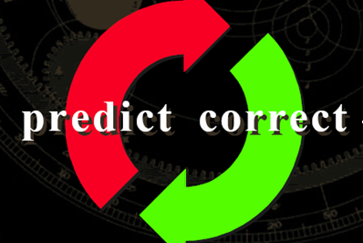
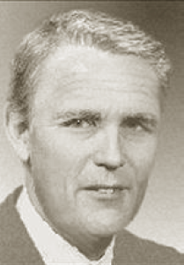
Kalman Filter : A Tool for Filtering, Prediction & Smoothing
Used in : Engineering, Physical Sciences, Biological Sciences, Economics, etc.
Forerunner : State Estimation for Control of Dynamic Systems

Slide 3
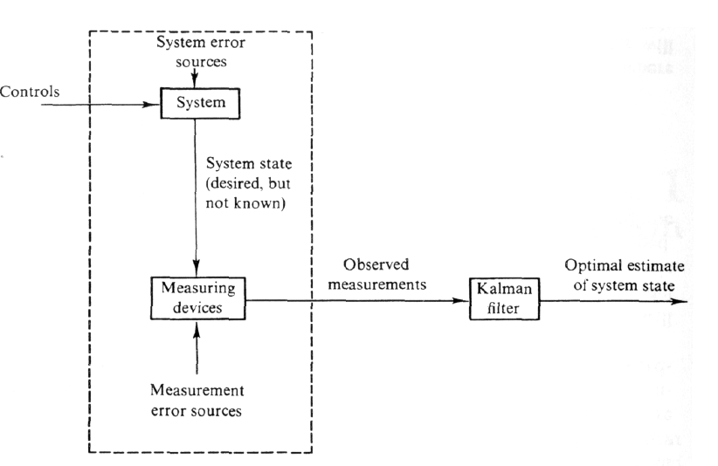
What does a Kalman Filter do, anyway?
The Kalman Filter is a recursion that provides the “best” estimate of the state vector x.
What’s so great about that?
Noise Smoothing
State Estimation
Recursive

Slide 4
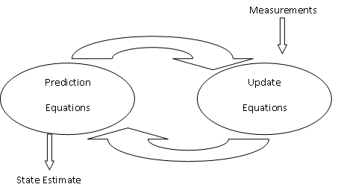
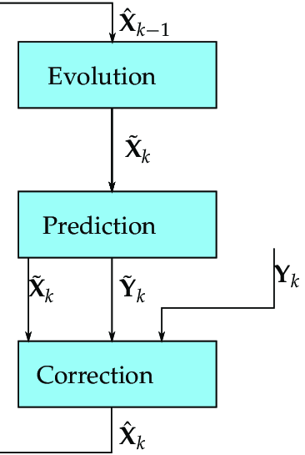
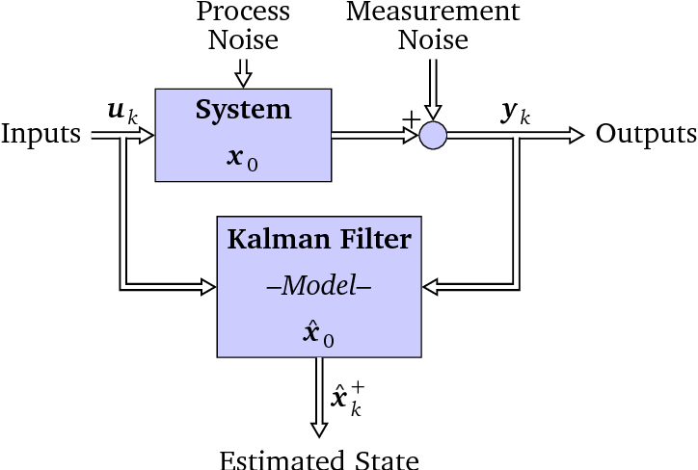

Slide 5
Understanding the Prediction & Update Process/ Steps

Slide 6



Understanding the Prediction & Update Process/ Steps
Update
Prediction
(k-1)+
(k)-
(k)+
k-1
k
z(k-1)
z(k)

Slide 7
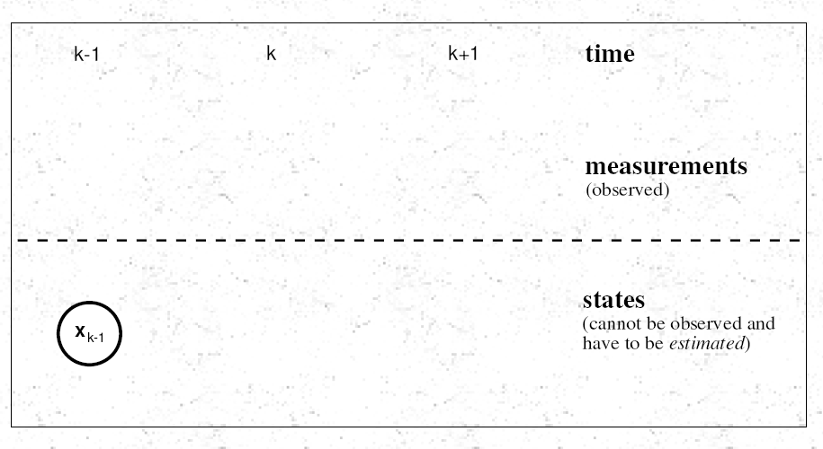
Propagating from (k-1) to (k) to (k+1)

Slide 8
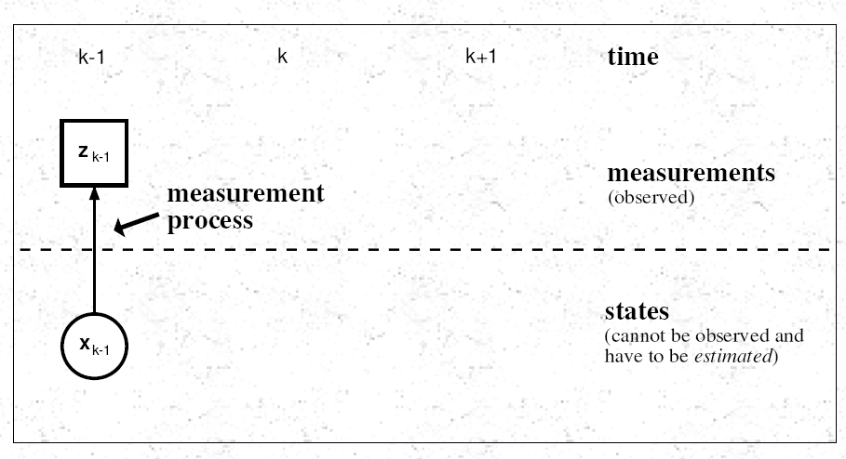

Slide 9
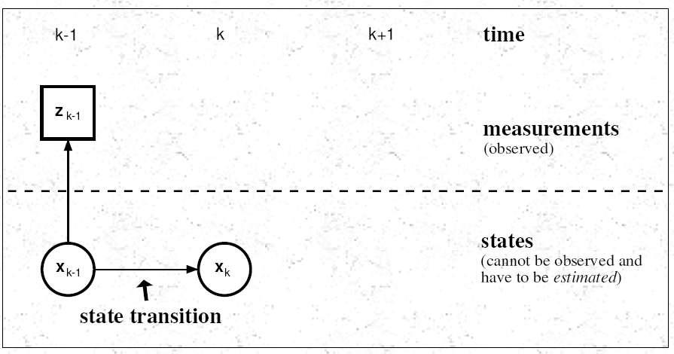

Slide 10
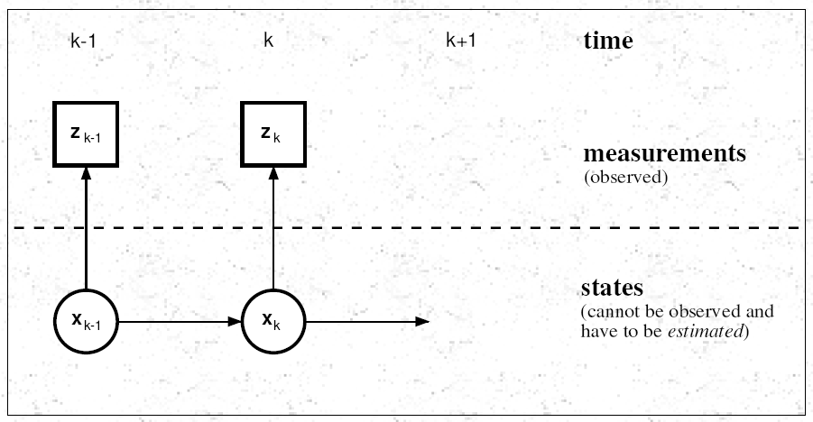

Slide 11
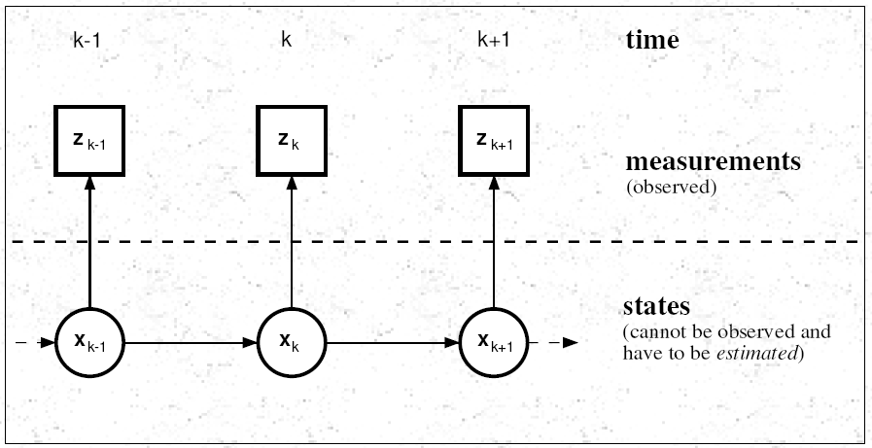

Slide 12
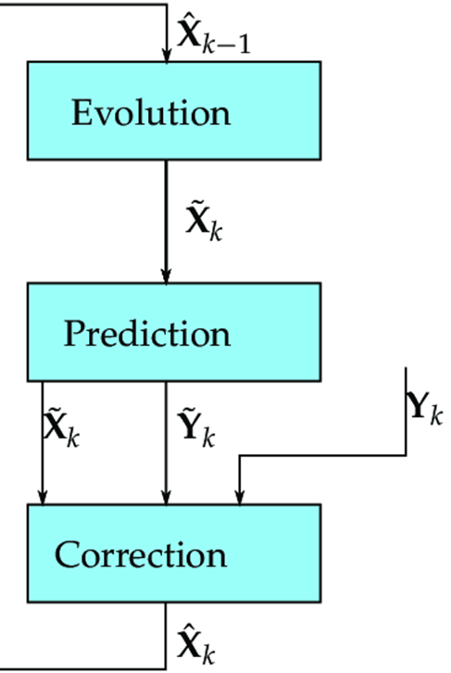

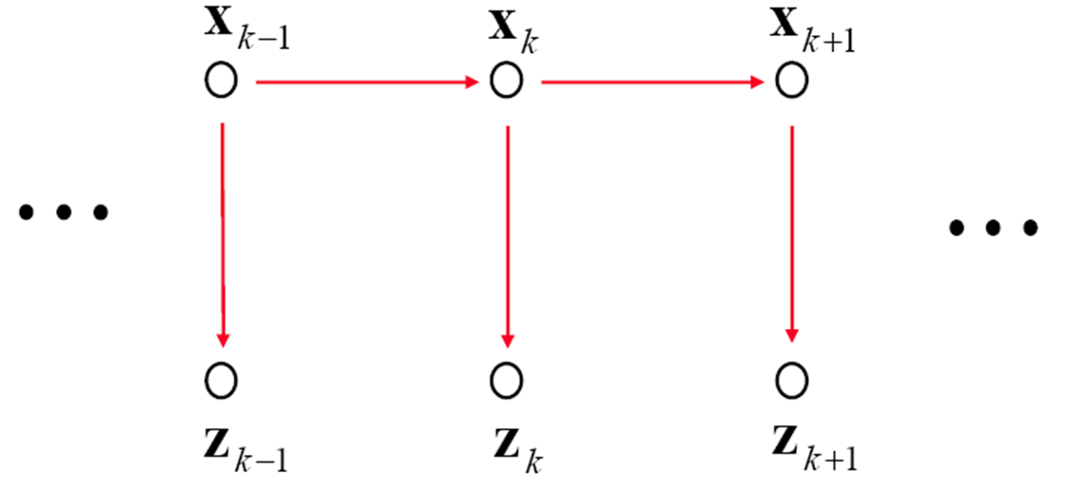

Slide 13
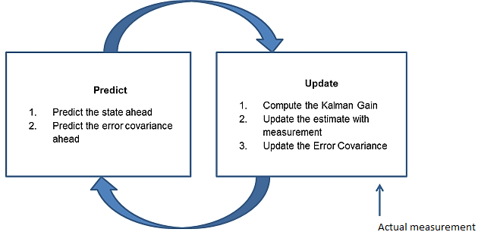
Prediction & Update

Slide 14
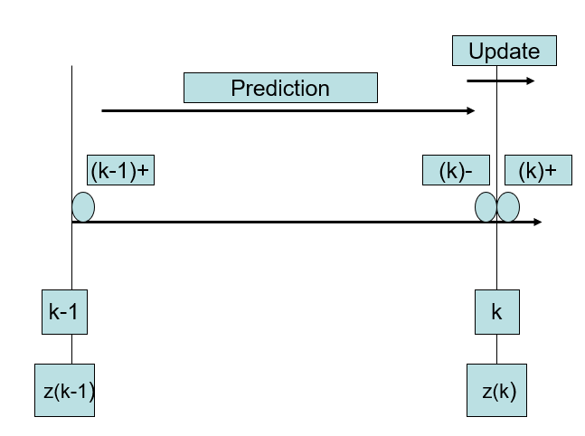
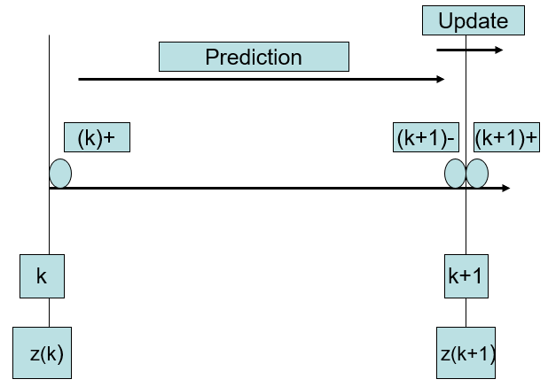
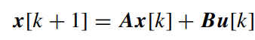

Prediction & Update
k-1
k
k+1
z(k-1)
z(k)
z(k+1)

Slide 15
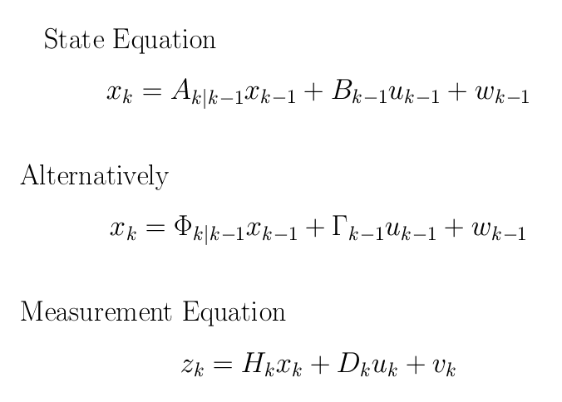
System Dynamics with Forcing Function & Noise

Slide 16
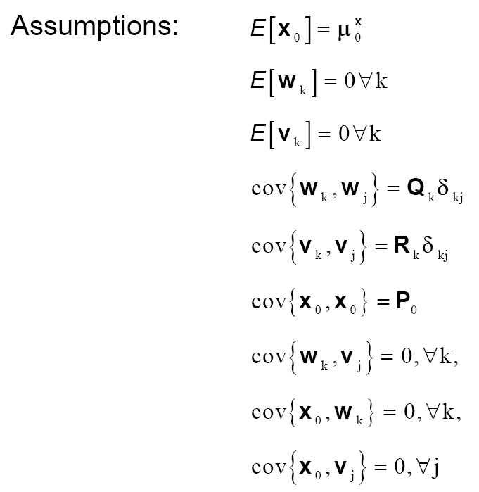

Slide 17
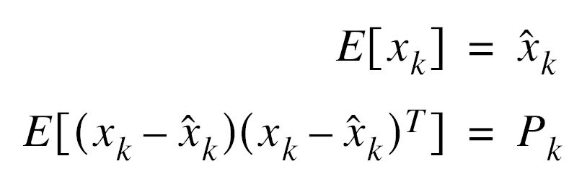
An Optimal State Estimator
Estimating the State
Minimizes the Error
Obtaining the Mean & Covariance

Slide 18
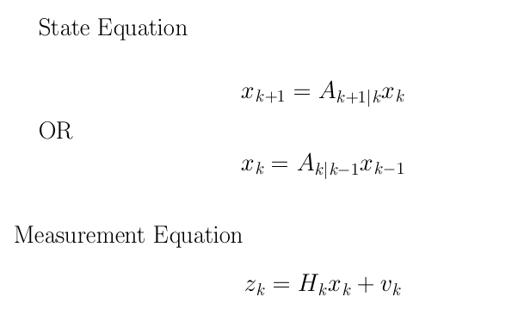
Simplified Derivation for a Deterministic & Unforced Dynamical System

Slide 19





Prediction & Update
Update
(k-1)+
Prediction
(k)-
(k)+
k-1
k
z(k-1)
z(k)

Slide 20
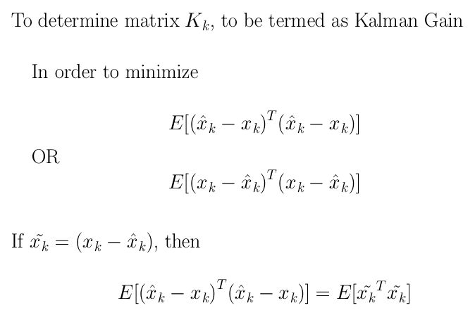
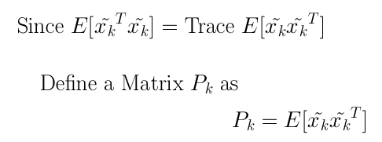
Kalman Gain & Covariance

